Slide 1
Machine Learning foundation

Slide 2
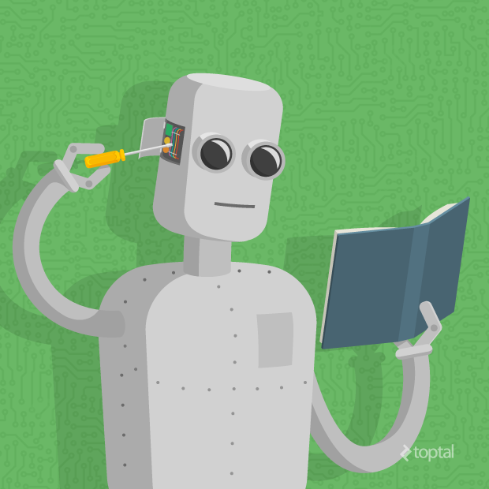
Topics to cover
What is Machine Learning?
Types of Machine Learning
Various Machine Learning Algorithms
Introduction to Data Analytics and ML Libraries
Introduction to Deep Learning

Slide 3

what IS MACHINE LEARNING?

Slide 4
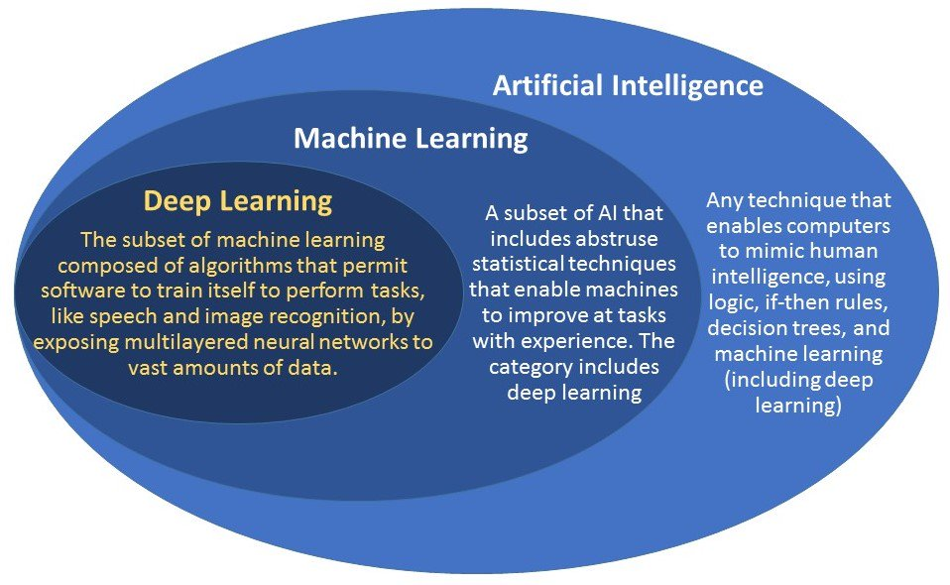
Machine learning is an application of artificial intelligence (AI) that provides systems the ability to automatically learn and improve from experience without being explicitly programmed. Machine learning focuses on the development of computer programs that can access data and use it learn for themselves.

Slide 5
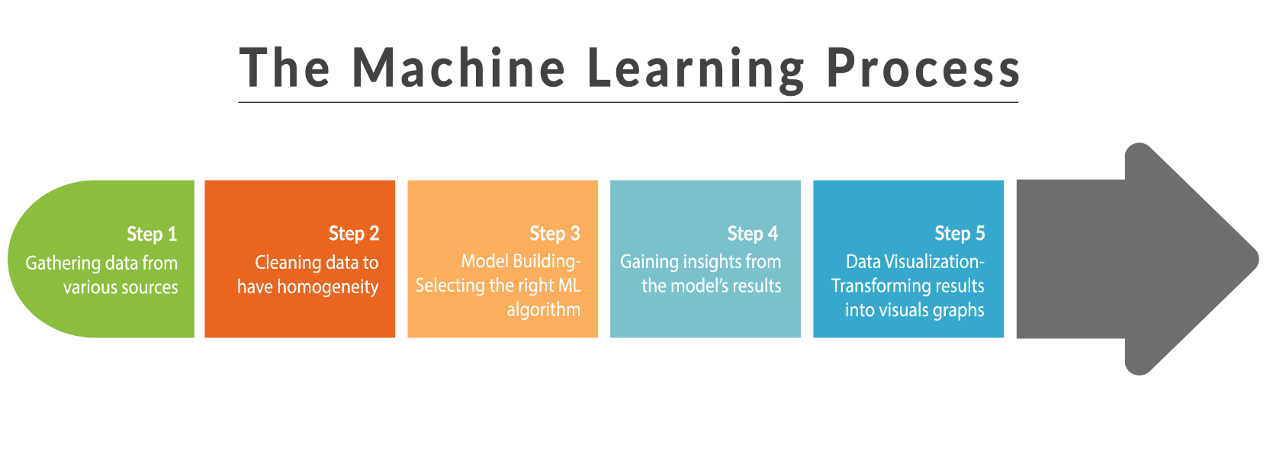
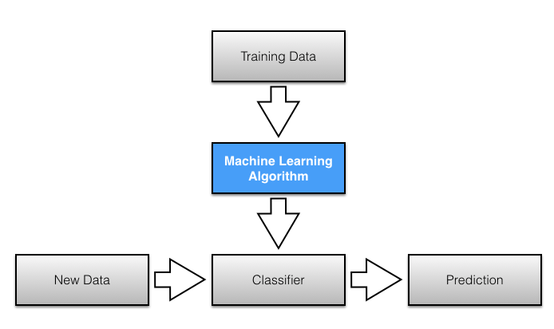

Slide 6
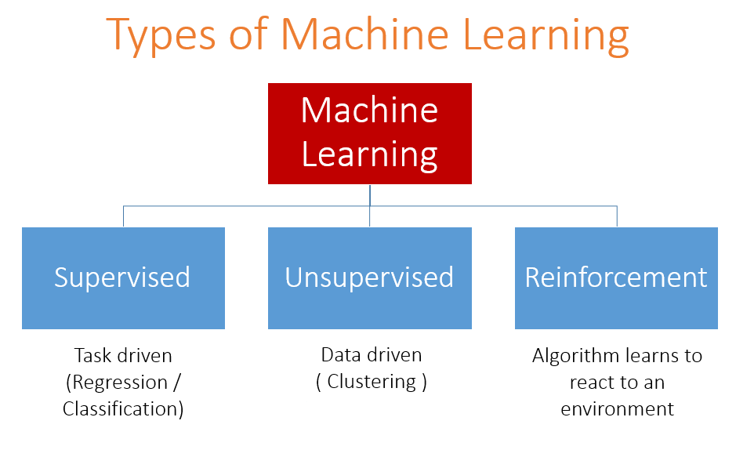

Slide 7
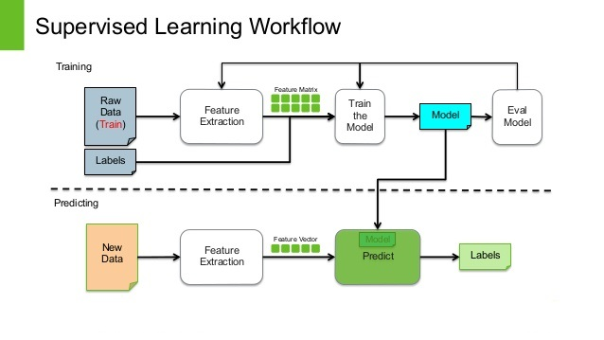

Slide 8
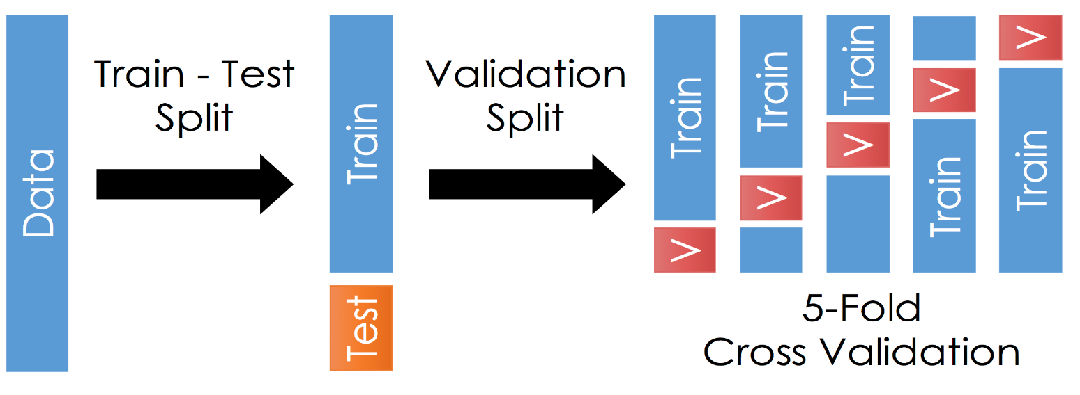
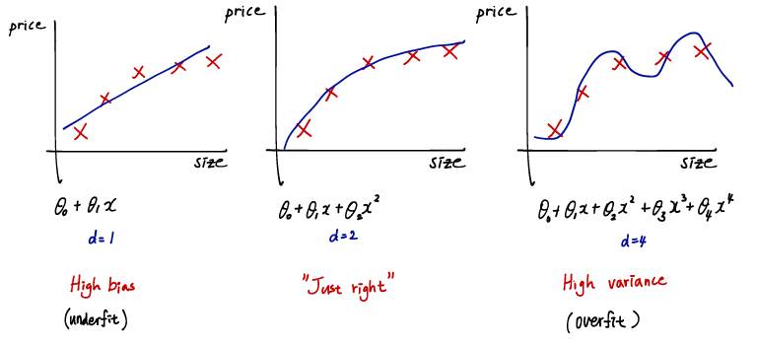
Some important ML concepts
Model evaluation procedures:
Train – Test on the same data
Train – Test split
K-Fold cross validation
Tradeoff while training Machine Learning Model:
Bias
Variance
High bias- We have high error rate with training and testing data.
Perfect fit- Low error rate with training and testing data.
High variance – We have low error rate while training but high error rate while testing due to inclusion of Noise and Unwanted Data points.

Slide 9
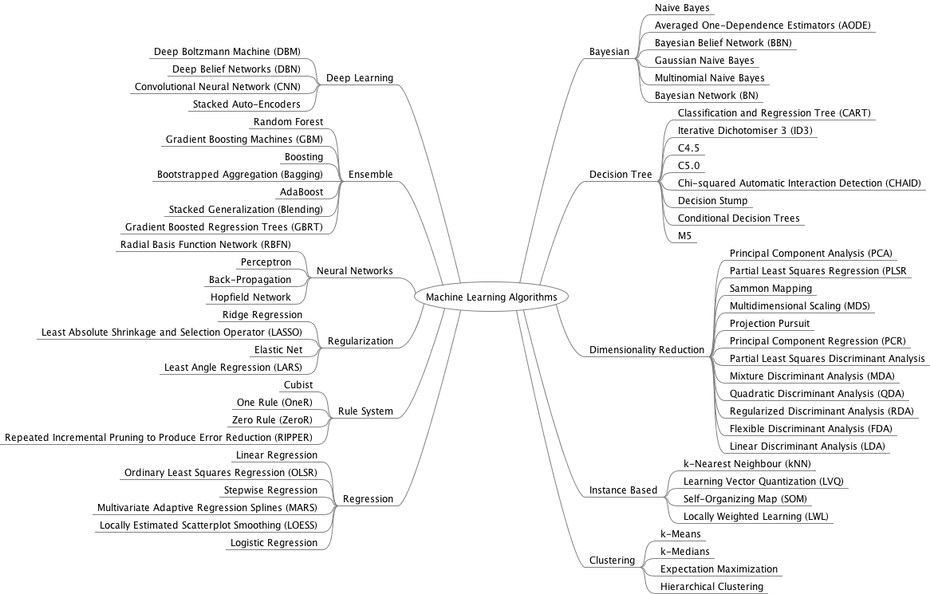
Various Machine Learning Algorithms

Slide 10
Some common machine learning algorithms
Supervised ML
Unsupervised ML
KNN
Linear Regression
Logistic Regression
Decision Trees
Clustering

Slide 11
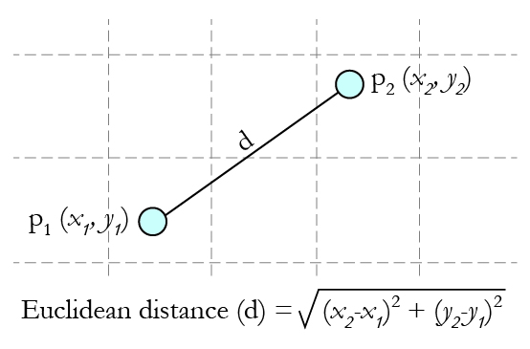
K-nearest neighbors
1) KNN can be used for both classification and regression predictive problems.
2) The algorithm is based on the concepts of Euclidian distance which is the distance between two data points.
3) Based on the distance between the out of sample data point and the existing class data point we can identify that under which class the out of sample data point falls.

Slide 12
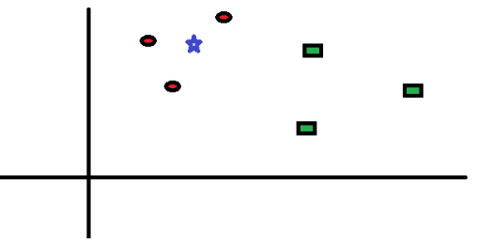
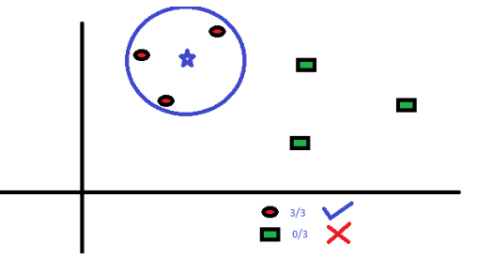
Figure 1
Figure 2

Slide 13
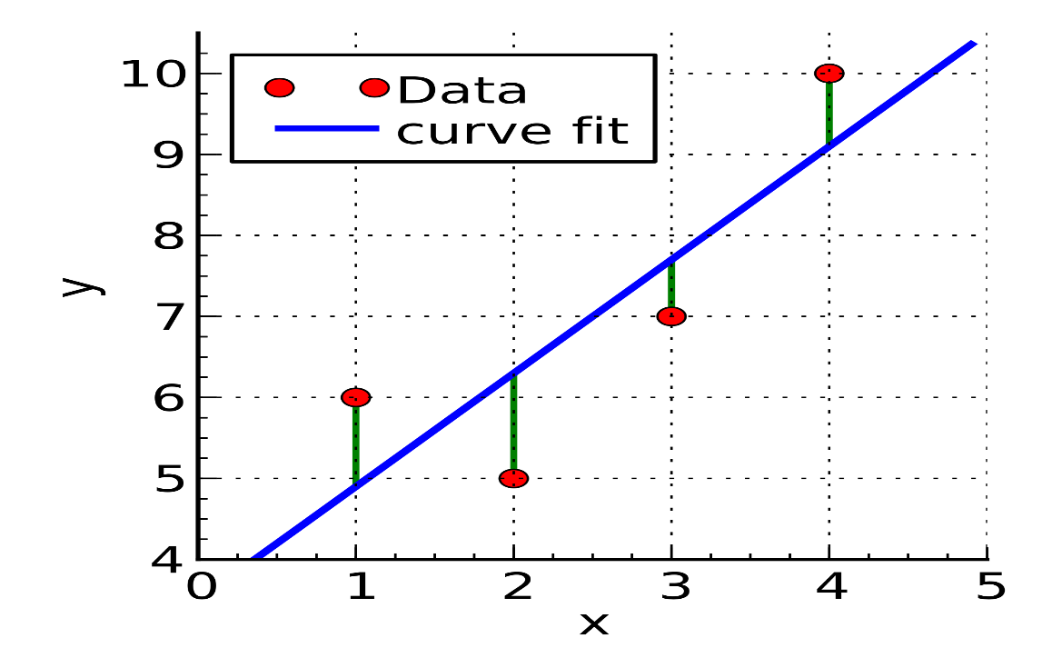
Linear Regression
1) The algorithm is specially designed for Regression problems.
2) No tuning parameter is required as required in KNN(value of K)
3) The algorithm works great for features and Response which are linear in nature.
4) The algorithm is based on the concept of Least squared distance criteria.

Slide 14
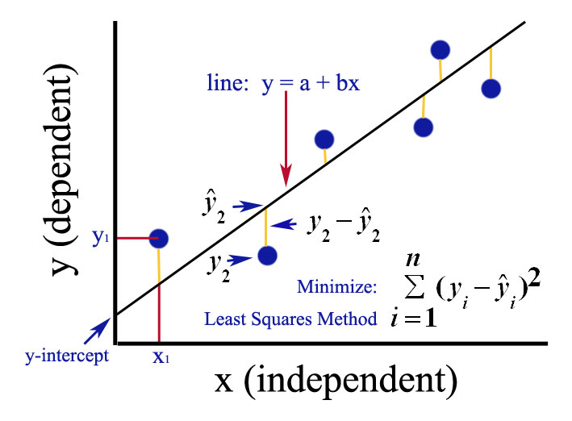

Slide 15
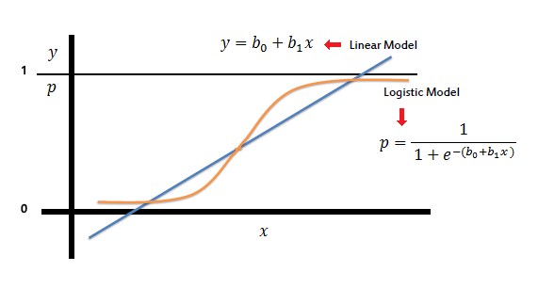
Logistic Regression
It’s a regression technique which is used to predict the output which is binary in nature.
The dependent and independent variables in the technique does not produce a straight line.
The output is calculated using probability which is derived by using linear regression equation.
The final generated curve is in the form of sigmoid function.

Slide 16
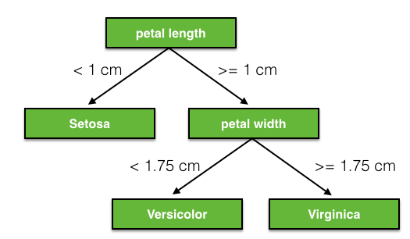
Decision trees
The algorithm is mostly used for classification problems.
The algorithm is based on two mathematical concepts which are:
Entropy
Information Gain
3) In this algorithm the depth of tree and the nodes / leaves decides the accuracy of the prediction based on out of sample data.
4) The algorithm is a top down approach which is developed by partitioning the data into subsets that contain instances with similar values (homogenous)

Slide 17
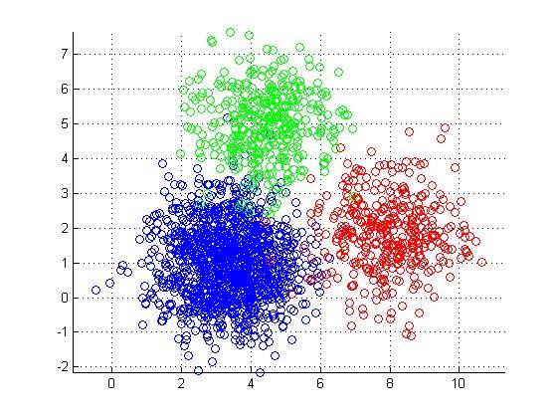
Clustering ALGORITHM
This algorithm is used to identify the patterns in the unlabeled data and based on that it predicts the nature of out of sample data.
In this algorithm in order to identify the patterns in data we use one of the popular algorithm which is K-means Clustering.
One of the best example of clustering is Market segmentation of customers. Ex: Suppose, you are the head of a rental store and wish to understand preferences of your costumers to scale up your business. Is it possible for you to look at details of each costumer and devise a unique business strategy for each one of them? Definitely not. But, what you can do is to cluster all of your costumers into say 10 groups based on their purchasing habits and use a separate strategy for costumers in each of these 10 groups. And this is what we call clustering.

Slide 18
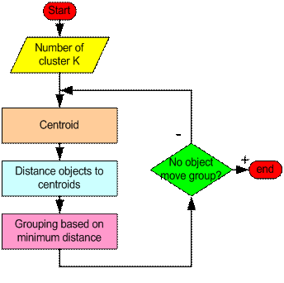
How the K-Mean Clustering algorithm works?
Clustering is done by calculating the Euclidian distance between data points and centroids.
Mean of distances are done to get the next position of cluster.
Again the data points which are closed to centroid A are considered as Class A else Class B.

Slide 19
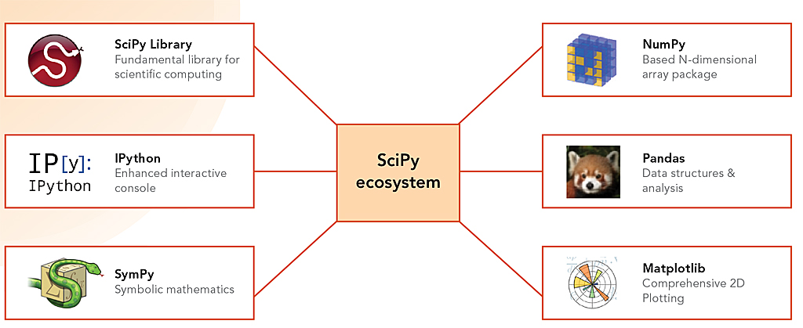
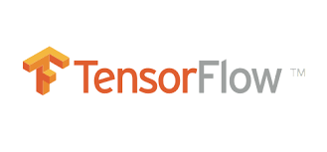

Data analytics and ml libraries:
There are various data analytics and machine learning libraries available in the market but the most powerful libraries are implemented in python language. Some of the best libraries which are used in this field are:
Pandas
Numpy
Matplotlib
Sklearn (Scikit Learn)
Beautiful soup
Tensor flow

Slide 20

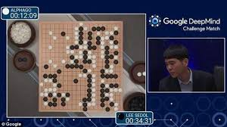
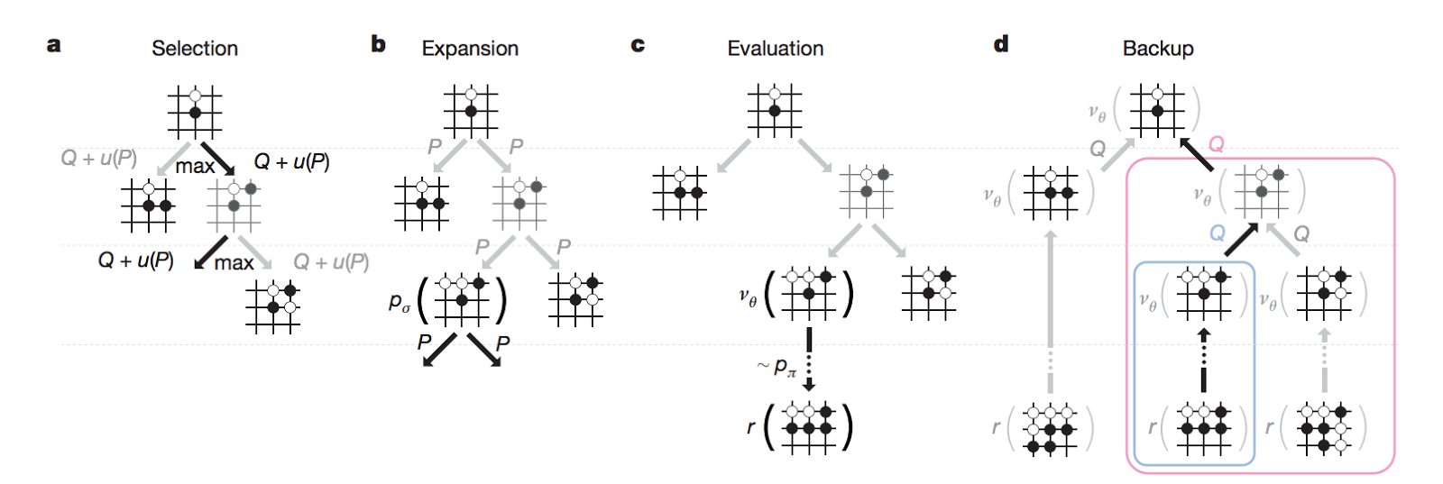
Introduction to deep learning
“DeepMind’s program AlphaGo beat Fan Hui, the European Go champion, five times out of five in tournament conditions...”
“AlphaGo was not preprogrammed to play Go: rather, it learned using a general-purpose algorithm that allowed it to interpret the game’s patterns.”

Slide 21
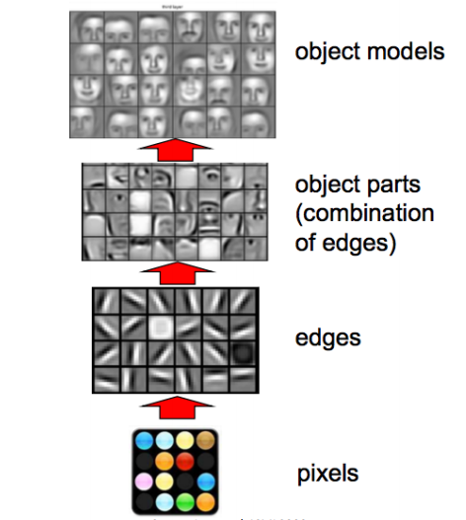
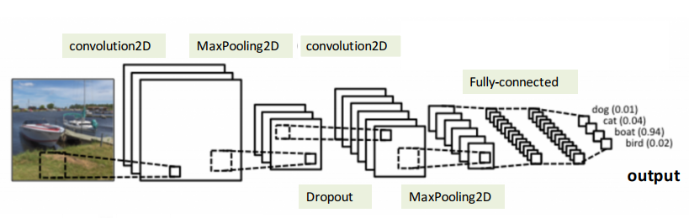
Face recognition systems
Object detection systems

Slide 22
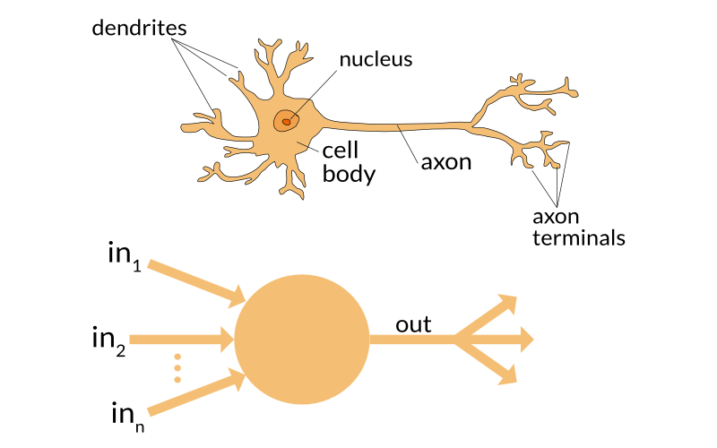
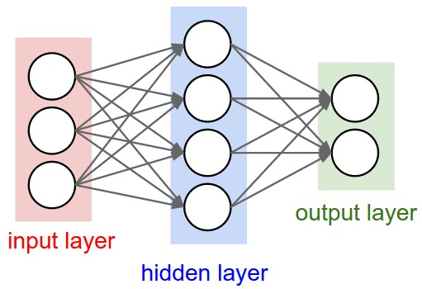

Slide 23
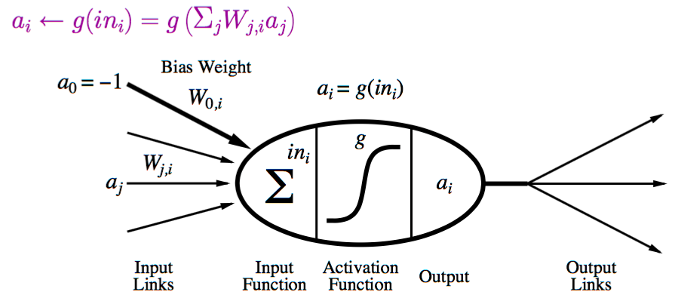
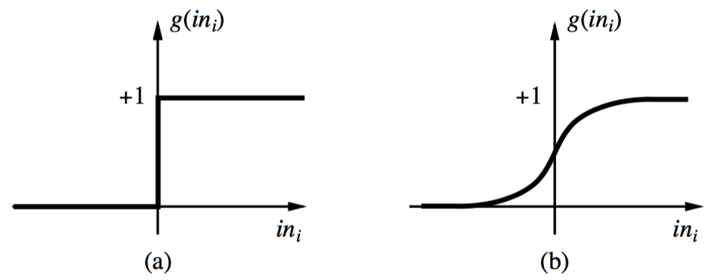
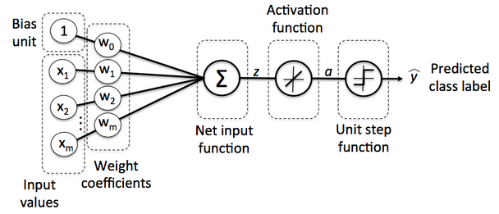
Possible activation functions:
Step function/threshold function
Sigmoid function (a.k.a, logistic function)

Slide 24
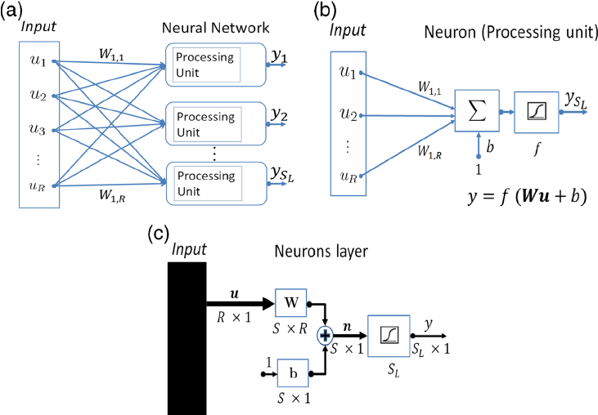
In Artificial Neural Networks there are 2 important concepts to deal with the dataflow, prediction by machine learning model and error correction. They are Feed forward & Back propagation
Feed forward:

Slide 25
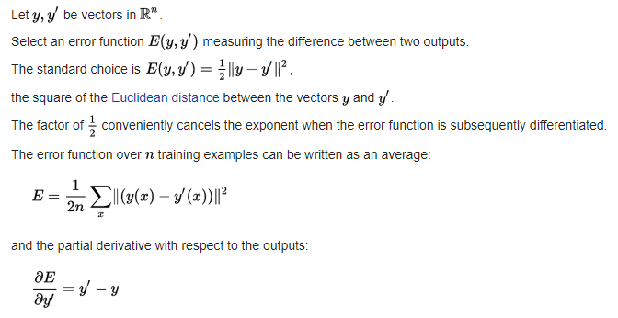
Backpropagation:
Backpropagation is a method used in artificial neural networks to calculate the error contribution of each neuron after a batch of data (in image recognition, multiple images) is processed. It is a special case of an older and more general technique called automatic differentiation. In the context of learning, backpropagation is commonly used by the gradient descent optimization algorithm to adjust the weight of neurons by calculating the gradient of the loss function. This technique is also sometimes called backward propagation of errors, because the error is calculated at the output and distributed back through the network layers.

Slide 26
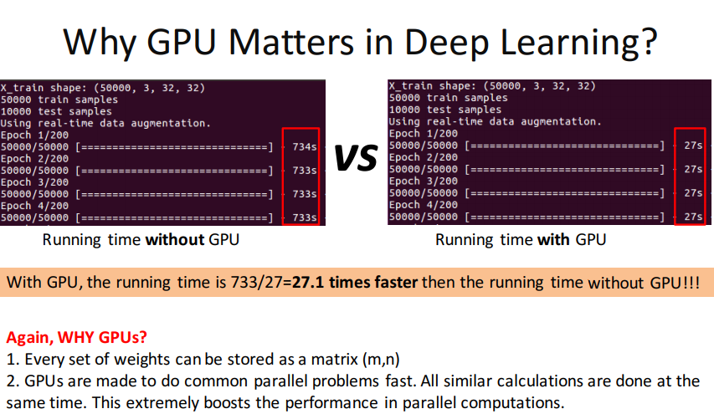
In GPU there are 100s of simple cores present to perform calculations where as in CPU there are very few complex cores present.
In GPU there are 1000s of concurrent hardware threads present to perform calculations where as in CPU there are small threads which are dedicated to overall system performance.

Slide 27
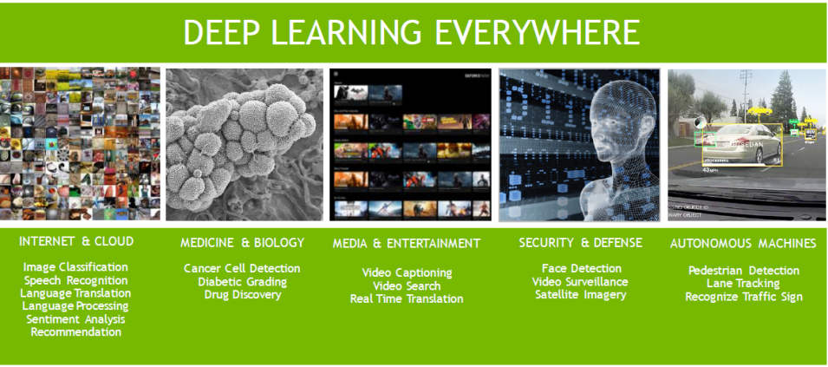

Slide 28
Any Questions??

